Slide 1
Keys in DBMS
10.1 and 10.2

Slide 2
Index
Super Key
Candidate Key
Primary Key
Alternate Key
Foreign Key
Compound Key or Composite Key or Concatenated Key
Natural Key or Semantic Key
Technical Key or Surrogate Key or Artificial Key

Slide 3
Key
Sname | City | Age
Amit | Bhopal | 22
Pushkar | Pinjore | 21
Amit | Bhopal | 22
Manik | Chandigarh | 22
Gurteg | Baddi | 21
Pushkar | Pinjore | 21

Slide 4
Key
SID | Sname | City | Age
S101 | Amit | Bhopal | 22
S102 | Pushkar | Pinjore | 21
S103 | Amit | Bhopal | 22
S104 | Manik | Chandigarh | 22
S105 | Gurteg | Baddi | 21
S106 | Pushkar | Pinjore | 21
Row, Record, Tuple
Any attribute can be a key or the combination of attributes can be a key which uniquely identify two tuples from the table. So we can say key can identify any row of data in a table uniquely. It is useful in maintaining integrity. It is helpful in identifying relationship and thus distinguish relationship from each other.

Slide 5
Super Key/ Key (SK/K)
SID | Sname | Marks | Department | Course
S101 | Amit | 78 | CSE | C1
S102 | Pushkar | 81 | EC | C2
S103 | Amit | 78 | CSE | C3
S104 | Manik | 80 | IT | C3
S105 | Gurteg | 82 | IT | C4
S106 | Pushkar | 81 | EC | C4
No two records should exactly be the same. It should be different. Some of them can be same.
Here SID is key
{Department, Course} key
{ Sname, Marks} not key
{Sname, Marks, Department, Course} key

Slide 6
Super Key/ Key (SK/K)
So super key is nothing but a key. So super key/key is an attribute or set of attributes that uniquely identify each record of relation. So the only one condition in super key is it can uniquely identify each record in the table. Super key is a theoretical concept. Here SID is key, so the super keys can be
{SID}
{SID, Sname}
{SID, Marks}
{SID, Sname, Marks}
{SID, Sname, Marks, Department}
{SID, Sname, Marks, Department, Course}
{Department, Course}
{Sname, Marks, Department, Course}
SK<=Attributes
Calculate how many maximum super key is possible in a relation:

Slide 7

Super Key/ Key (SK/K)

Slide 8
Find out the super keys in this relation
A | B | C | D
1 | 1 | 5 | 1
2 | 1 | 7 | 1
3 | 1 | 7 | 1
4 | 2 | 7 | 1
5 | 2 | 5 | 1
6 | 2 | 5 | 2
{B,C,D}
{B}
{B,C}
{A}, {A,B}, {A,C}, {A,D}, {A,B,C}, {A,C,D},{A,B,D}, {A,B,C,D}

Slide 9
Candidate Key (CK)
A | B | C
1 | 1 | 1
2 | 1 | 2
3 | 2 | 1
4 | 2 | 2
Candidate key is a super key but it is a minimal super key. Candidate key is a super key such that whose proper subset will not be key or super key. Every CK is a SK but not every SK is a CK.
SK: A, AB, AC, ABC, BC
CK: A, BC

Slide 10
Primary Key (PK) [Unique + Not Null)
A | B | C
1 | 1 | 1
2 | 1 | 2
3 | 2 | 1
4 | 2 | 2
A primary key is a column or attribute in the table or relation whose purpose is to uniquely identify records in the table along with there must be some value associated with it So it should be selected in the manner such that it is unique and not null. The primary key is chosen or selected from the candidate key. There is only one PK for a single table. Other remaining keys are called alternate keys. PK is CK. May be the combination of attributes.
SK: A, AB, AC, ABC, BC
CK: A, BC
PK: A
AK: BC

Slide 11
Foreign Key (FK)
A foreign key is different from a super key, candidate key or primary key because a foreign key is the one that is used to link two tables together or create connectivity between the two.
A foreign key is the one that is used to link two tables together via the primary key. It means the columns of one table points to the primary key attribute of the other table. It further means that if any attribute is set as a primary key attribute will work in another table as a foreign key attribute. But one should know that a foreign key has nothing to do with the primary key.
The use of a foreign key is simply to link the attributes of two tables together with the help of a primary key attribute. Thus, it is used for creating and maintaining the relationship between the two relations.

Slide 12
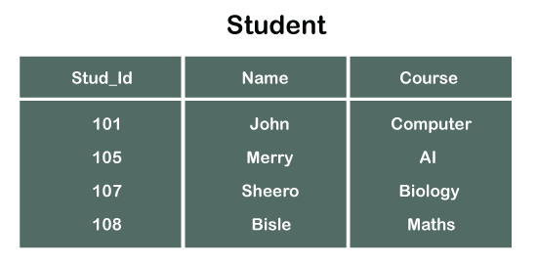
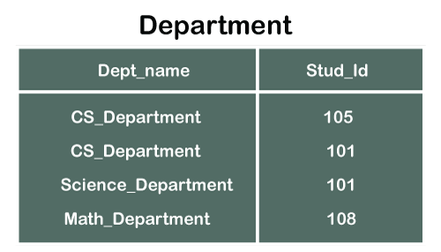
Example
In the tables, one attribute, you can see, is common, that is Stud_Id, but it has different key constraints for both tables. In the Student table, the field Stud_Id is a primary key because it is uniquely identifying all other fields of the Student table. On the other hand, Stud_Id is a foreign key attribute for the Department table because it is acting as a primary key attribute for the Student table. It means that both the Student and Department table are linked with one another because of the Stud_Id attribute.

Slide 13
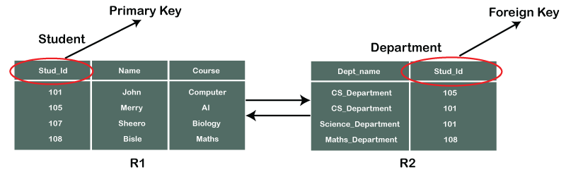
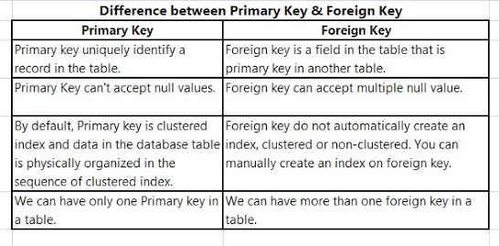
Referential Integrity in DBMS is developed from the concept of the foreign key. It is clear that a primary key is an alone existing key and a foreign key always reference to a primary key in some other table, in which the table that contains the primary key is known as the referenced table or parent table for the other table that is having the foreign key.
A foreign key value must match an existing value in the parent table or be null. It means we only insert those value which are present in base table. If we delete the baser table automatically primary key and foreign key relationship is broken.

Slide 14
Compound key
It is a key that consist of two or more attributes or columns.

Slide 15
Natural Key vs. surrogate key
When you design tables with SQL Server, a table typically has a column or a number of columns that are known as the primary key. The primary key is a unique value that identifies each record. Sometimes the primary key is made up of real data and these are normally referred to as natural keys, while other times the key is generated when a new record is inserted into a table. When a primary key is generated at runtime, it is called a surrogate key. A surrogate key is typically a numeric value. Within SQL Server, Microsoft allows you to define a column with an identity property to help generate surrogate key values.
A natural key is a single column or set of columns that uniquely identifies a single record in a table, where the key columns are made up of real data. When I say “real data” I mean data that has meaning and occurs naturally in the world of data. A natural key is a column value that has a relationship with the rest of the column values in a given data record. Here are some examples of natural keys values: Social Security Number, ISBN, and TaxId.
A surrogate key like a natural key is a column that uniquely identifies a single record in a table. But this is where the similarity stops. Surrogate keys are similar to surrogate mothers. They are keys that don’t have a natural relationship with the rest of the columns in a table. The surrogate key is just a value that is generated and then stored with the rest of the columns in a record. The key value is typically generated at run time right before the record is inserted into a table. It is sometimes also referred to as a dumb key, because there is no meaning associated with the value. Surrogate keys are commonly a numeric number.

Slide 16


